Slide 1
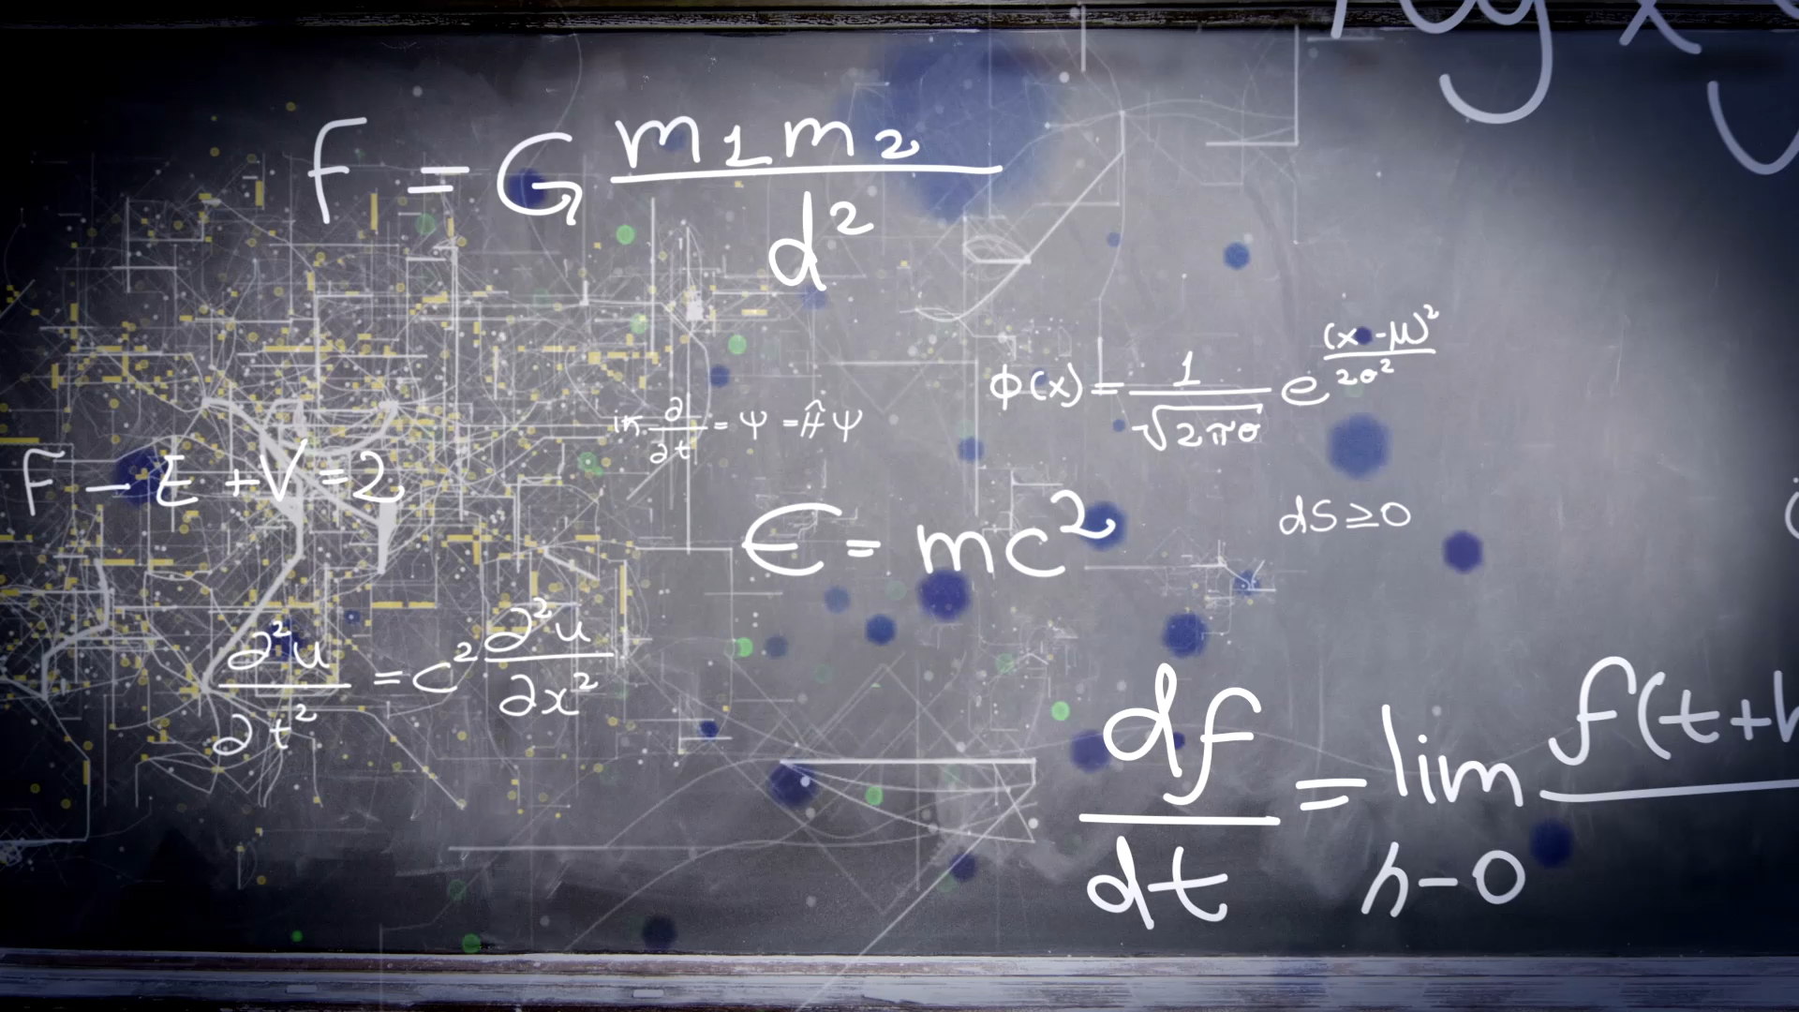
Boosting Algorithm
In Machine Learning Regression

Slide 2
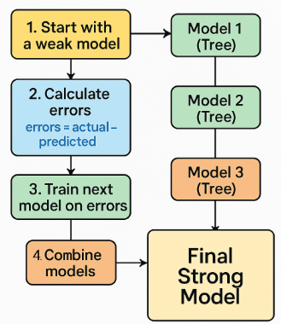
Boosting
Boosting is an ensemble learning technique — meaning it combines multiple weak models (usually Decision Trees) to make one strong model.

Slide 3

Scenario
Imagine you are trying to predict the price of a car.
You ask one friend (a weak learner). He gives an approximate guess — not perfect.
You ask another friend, but this time you tell him where the first friend made mistakes, so he tries to fix those mistakes.
You keep repeating this — each friend (model) focuses on errors made by the previous one.
In the end, you combine everyone’s answers to get a very accurate prediction.
That’s Boosting in action.

Slide 4
Popular Boosting Algorithms
Algorithm | Description | Common Use
AdaBoost | Adjusts weights of data points based on errors | Classification & Regression
Gradient Boosting (GBM) | Uses gradient descent to minimize error | Regression
XGBoost / LightGBM / CatBoost | Faster, optimized versions of GBM | Large datasets, modern ML projects

Slide 5

Why Use Boosting Algorithm?
✅ Increases accuracy ✅ Works well on both small & large datasets ✅ Automatically handles complex patterns ⚠️ But can overfit if too many trees are added

Slide 6
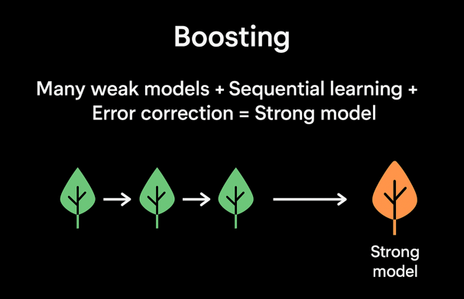
Summary (Easy to remember)

